Slide 1
Emails From Hong Kong
Re: Bank transfer - Mortgage
From David Vrijmoed <dvrijmoed@gmail.com>
Date. Wed 2/25/2009 7:15 PM
TQ christine moyer <christinemoyer@hotmail.com>
Hi Chris,
I gave instructions to the bank yesterday (25 Feb) to transfer US$99,000 to your account mentioned below. So you should receive it hopefully in the next 1 to 2 days.
Justin is over all his recent minor ailments such as coughing, runny nose etc. but we're now right in the middle of the peak flu season here so fingers crossed he stays healthy. Glad to hear Max is getting better as well.
Regards, Dave.
On Thu, Feb 19, 2009 at 1:32 AM, christine moyer <christinemoyer@hotmail,com>-wrote: Hi Dave,
Below is the information you will need for the wire transfer. Thanks again for your time and effort.
Bank: Bank of America
Account Holder: Robert and Christine Moyer Account Number: 77188654
SWIFT Code: BOFAUS3N
Wire Transfer number: 026009593
Bank address: 101 Kirkland Ave, Kirkland, WA 98033
How is Justin? Max has been sick for a while now. the antibiotics made him vomit and have loose stools for over week. It .was awful. I think he is on the mend .now.
Say hello to Janet.
Chris

Slide 2
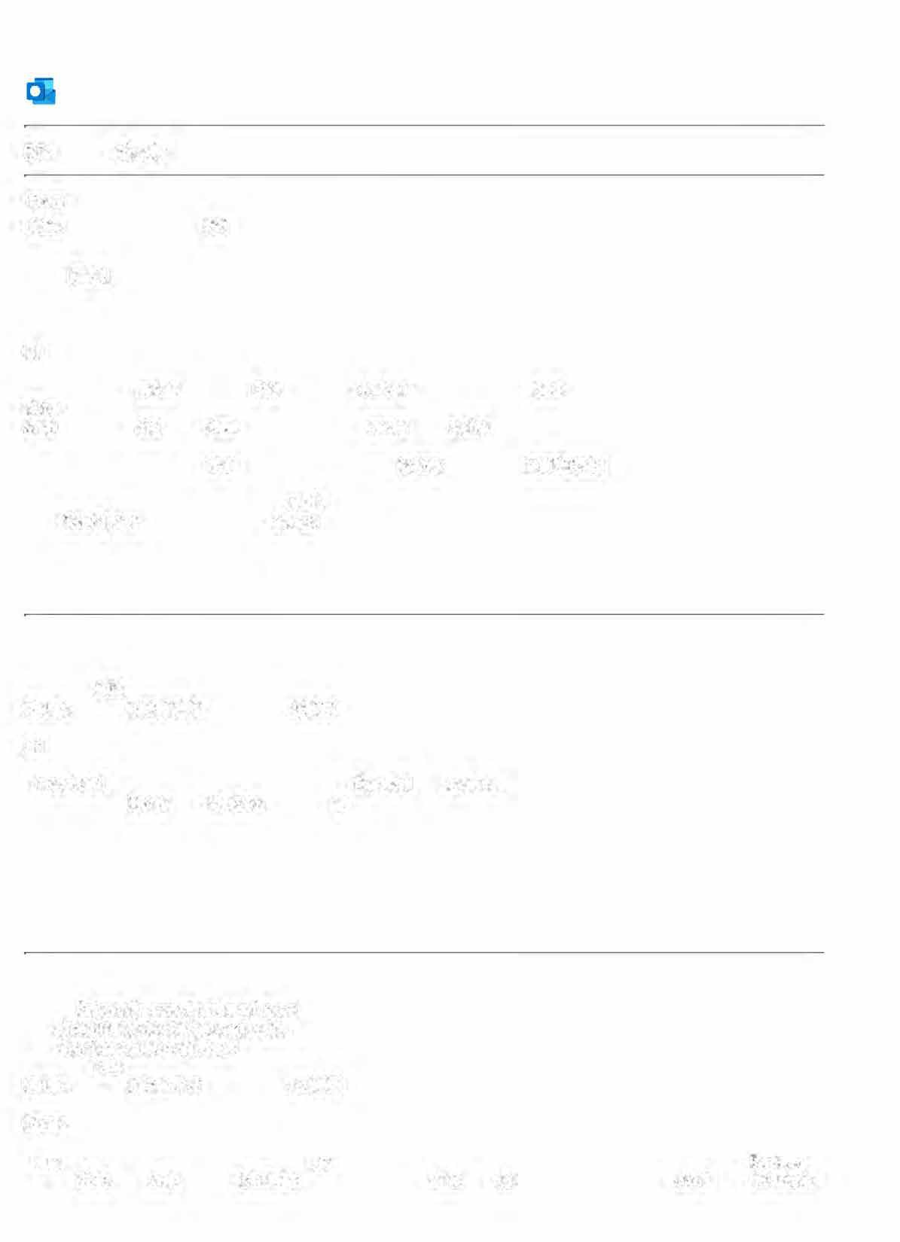
•
Outlook
RE: foreign check
From Franciscus Vrijmoed <fajmvrijmoed@hotmail.com> Date Tue 2/3/2009 11 :49 PM
To christine moyer <christinemoyer@hotmail.com> Cc David Vrijmoed <dvrijmoed@gmail.com>
HI Chris,
You see, they want to delay. Did they not cash a similar cheque last year? What about you ask them why they accepted it last year?
And how long did they keep the checq and could you claim compensation?
Anyhow, I understand, we always lose fighting these croocked institutes!
Now, the only thing we can do is wait for the cheque. In the meantime give David precise instructions about your or Rob's account.
Love,
Pa.
From: christinemoyer@hotmail.com To: fajmvrijmoed@hotmail.com Subject: RE: Transfers./answer Pa. Date: Tue, 3 Feb 2009 11:46:21 ·-0900
Hi Pa,
I received the check yesterday. They say the will not cash a foreigh check which is ridiculous. I will mail back to Dave and we can arrange a bank transfer to my account.
Thanks again, Chris
From: fajmvrijmoed@hotmail.c;om To: chrlstinemoyer@hotmall.com CC: dvrijmoed@gmail.com Subject: RE: Transfers./answer Pa.
Date: Tue, 3 Feb 2009 04:22:43 +0000
Dear Chris,
I am not surprised that the co. is in no hurry to send the check back. After all, they cannot oe too happy that you are paying back so much money in one go, as their cash does not earn any interest

Slide 3
From: fajmvrijmoed@hotmail.com To: christinemoyer@hotmail.com CC: dvrijmoed@gmail.com Subject: Transfers.
Date: Fri, 30 Jan 2009 12:54:20 +0000
Hi my lovely Chris,
I heard from David that again there are problems with our recent remittance to you. This time it seems the problem is definitely on the American side. As my account was debited on Jan. 9th, it seems the Bank is till sitting on the monies.
Moreover I now have to hold the remainder US$21,000 until we find out what the problem is.
As a matter of fact why did we not transfer the monies direct to your or Robert's NC as we did in the past? That took about 2 days only and you could immediately transfer it to the mortgage co's a.c.
So David and I are now waiting for news from you. Love, Pa.

Slide 4
To answer your questions -
Any amount you want to send if fine. We would be happy with any amount.
The max we can receive is $99,000.
Once the money is in our bank account it will take about 4-5 business days to pay the mortgage company.
We currently owe about USD$522,000 at a 4.95% interest rate.
Once we get the loan below USD$417,000 we can refinance at a better rate. Anything abover USD$417,000 is considered a "Jumbo Loan" in the US, so they charge a higher interest rate.
If you transfer USD$91,000, we will owe USD$431,000. Robert and I were thinking of selling some stock or taking out a small loan to pay down the mortgage below USD$417,000 so we can qualifiy for the better rate.
Mortgage rates are low currently so we should be able to refinance at anytime.
I can send you the new payment amounts after we apply the additioanl principal to the loan.
I have sent the wire instructions to Dave today.
How is everything in Shenzhen?
SBUX announced layoffs last week and released 340 people at the corporate headquarters, about 10% of the people in my building. Fortunately the people in my department were not affected, but we did slash our travel budget by 75%, eliminated all professional fees paid to outside consultants, and closed 5 open positions that we were trying to fill. Basically we do more work with fewer people, and have less professional advice from outside tax consultants. But I am happy to have a job.
Max and Elsa are doing well. We have switched Masses and are now attending the 5:30pm Mass on Sunday night as it is designed for teens and children. Max seems to enjoy the other babies and the singing. Elsa likes it because she sees her friends, so its a win win for all.
Robert is doing well at work so we believe he is safe from layoffs too. Love you,
Chris
From: fajmvrijmoed@hotmail.com To: christinemoyer@hotmail.com CC: dvrijmoed@gmail.com Subject: Mortgage
Date: Wed, 18 Feb 2009 13:47:40 +0000
Hi my Dear(est) Chris,
I received the cheque back a few days ago and therefore the following:
A) At present I can send to your account (or Robert's) US$91,000.--.
But please let me know the maximum amount you can receive, e.g. 99,000 or less, although I may at present not send the difference together with the 91,000.
This is because Mam's account is overdrawn HK$250,000 and has only a margin of about HK$30,000 left which means I may have to bail her out (again)!
Therefore, please let me know the ultimate date I have to send the monies (either 91,000 or more) so that your mortgage is already the equivalent amount lower
on 1st March.
Further for my own information the exact amount outstanding on 1st March and how much monthly interest (only the interest and insurance) you are paying NOW and after 1st March!

Slide 5
Emails Between Christine and Robert
Refund- I got the 3k as requested, plus some other for the boys. I'll set up a Bofa like you and move it over.
Unemployment- I am a couple weeks behind because we were not doing anything, but I will get caught up.
Vrijmoeds- There were delays and hiccups on the last gift. Was that finalized, or is there anything outstanding?
[Quoted text hidden)
christine moyer <christinemoyer@hotmail.com> To: Rob Moyer <rob.moyer@gmail.com>
Wed, Dec 27, 2023 at 8:52 AM
Ok. The 3k was for the first trip for expenses. I thought you covered prescriptions that were 1k plus and other trip expenses for helping out with surgery on subsequent trips?
I don't know what you are referring to on Vrijmoed gifts? Get Outlook for iOS
From: Rob Moyer <rob.moyer@gmail.com>
Sent: Wednesday, December 27, 2023 8:47 AM
[Quoted text hidden] [Quoted text hidden)
Rob Moyer <rob.moyer@gmail.com>
To: christine moyer <christinemoyer@hotmail.com>
Wed, Dec 27, 2023 at 8:57 AM
The trip was 2k. The Rx was lK. That is a total of 3k. That was what we discussed. It is in our running list since it began.
Your mom and Dad gave us another gift (I think it was in the spring). They gave it to all three of the kids. Uncle Mark even brought it up when he was here. Then you kept telling me that your mom was doing things with part of it and would get the rest of it to us later. We had that discussion prior to July s^{th} many times. I am surprised that you do not remember their last gift to us. You really don't remember?
From: christine moyer <christinemoyer@hotmail.com>
Sent: Wednesday, December 27, 2023 8:52 AM
To: Rob Moyer <rob.moyer@gmail.com>
[Quoted text hidden]
[Quoted text hidden)
christine moyer <christinemoyer@hotmail.com> To: Rob Moyer <rob.moyer@gmail.com>
Wed, Dec 27, 2023 at 9:08 AM
07/27/2023 | WIRE TYPE:INTL IN DAT :230727 TIME:0425 ETTRN:XXXXXXXXXX1464l 1... View/Edit | Credi! | $3.750.00
07/14/2023 | WIRETYPE:INTL IN DATE:230714 TIME:0422 ETTRN:XXXXXXXXXX017670... | Credi! | $10,000.00
 | View/Edit
07/13/2023 | WIRETYPE:INTL IN OATE:230713 TIME:0428 ETTRN:XXXXXXXXXX102245... | Credit | $10,000.00
 | View/Edit
03/09/2023 | WIRE TYPE.INTL IN DATE.230309 TIME:0435 ETTRN.XXXXXXXXXX094308... | Credi! | $9,000.00
 | View/Edit
03/08/2023 | WIRE TYPE.INTL IN DATE.230308 TIME:0429 ET TRN:XXXXXXXXXXl 59167,~ |  | $9.000.00
 | View/Edit
02/2812023 | WIRE TYPE INTL IN OATE.230228 TIME:0437 ET TRN XXXXXXXXXX091376. V1ew/Ed1t | Credit | $7.620.00

Slide 6
From: Rob Moyer <rob.moyer@gmail.com>
Sent: Wednesday, December 27, 2023 7:57 AM
[Quoted text hidden]
[Quoted text hidden)
christine moyer <christinemoyer@hotmail.com> To: Rob Moyer <rob.moyer@gmail.com>
Wed, Dec 27, 2023 at 9:09 AM
It was all transferred.
From: christine moyer <christinemoyer@hotmail.com>
Sent: Wednesday, December 27, 2023 8:08 AM
[Quoted text hidden]
[Quoted text hidden)
Rob Moyer <rob.moyer@gmail.com>
To: christine moyer <christinemoyer@hotmail.com>
Wed, Dec 27, 2023 at 9:16 AM
Got it.
Was this the full expected total equivalent to your siblings or just the part before you went to Hong Kong and discussed me with your Mother?
Not trying to be difficult at all, but I just want to be sure I am asking the right question because they all stopped after Hong Kong. Thanks again.
[Quoted text hidden]
christine moyer <christinemoyer@hotmail.com> To: Rob Moyer <rob.moyer@gmail.com>
Wed, Dec 27, 2023 at 9:20 AM
This is the full amount that went to all siblings.
Btw my running total for Bend trips before I stopped tracking was more than the 3k. One plane ticket alone was 750, add in hotel for multiple stays plus other airline tickets, but if that's your number. I can go back and add up if you want.
Get Outlook for iOS
From: Rob Moyer <rob.moyer@gmail.com>
Sent: Wednesday, December 27, 2023 9:16:10 AM
[Quoted text hidden]
[Quoted text hidden)
Rob Moyer <rob.moyer@gmail.com> To: Rob Moyer <rob.moyer@gmail.com>
Sat, Jun 22, 2024 at 8:18 PM
Refund
[Quoted text hidden]

